Slide 1
Function Oriented Design and Detailed Design

Slide 2
Some Concepts

Slide 3
Software Design
Noun :
  Represents the abstract entity -design- of a system
  Design of an existing system
  Every existing system has a design
  Design of a system to be constructed
  Design is a plan for a solution
Verb :
  The process of design(ing), which results in a design
  Resulting design is a plan for a solution

Slide 4
Design…
Design activity begins with a set of requirements
Design done before the system is implemented
Design is the intermediate language between requirements and code
Moving from problem domain to solution domain
Proceeding from abstract to more concrete representations
Result is the design to be used for implementing the system

Slide 5
Design…
Design is a creative activity
Goal: to create a plan to satisfy requirements
Perhaps the most critical activity during system development
Design determines the major characteristics of a system
Has great impact on testing and maintenance
Design document forms reference for later phases

Slide 6
Levels in Design Process
Architectural design
  Identifies the components needed for the system, their behavior, and relationships
  We have already discussed it
High Level Design
  Really is the module view of the system
  I.e. what modules are in the system and how they are organized

Slide 7
Levels..
Logic design
  Components and modules are designed to satisfy their specs
  How to implement components
  Algorithms for implementing component are designed
Complete design: the architectural design, the high level design, and Logic design of each component

Slide 8
Design Methodologies
Many possibilities for design, methodologies aim to reduce search space
Provide some discipline for handling complexity
Most methodologies deal with high level design
Provide a set of rules for guiding the designer
Rules do not reduce design to a sequence of mechanical steps
Many methodologies exist
Diff. methodologies may be useful for diff. applications

Slide 9
Design Objectives
Goal is to find the best possible design
Have to explore different designs
Evaluation criteria are often subjective and non quantifiable
Major criteria to evaluate a design
  Correctness
  Efficiency
  Maintainability
  Cost

Slide 10
Correctness is the most fundamental
  Does design implement requirements?
  Is design feasible, given the constraints?
Efficiency
  Concerned with the proper use of scarce resources - processor & memory
  Other factors same, efficiency should be maximized

Slide 11
Maintainability
  Most important quality criteria
  Most affected by architectural design
  Should facilitate testing
  Should facilitate discovery and correction of bugs
  Make modifying the system easier
Cost
  For same quality, minimize cost
  Design costs are quite small
  Should try to minimize cost in later phases

Slide 12
Design Principles
Design is a creative process
How to create a design from abstract requirements
There are principles for guiding during design
Two fundamental principles in the design process
  Prob partition
  Abstraction

Slide 13
Problem Partitioning
Basic principle "divide and conquer"
Divide the problem into manageably small pieces
  Each piece can be solved separately
  Each piece can be modified separately
  Pieces can be related to the application
Pieces cannot be independent; they must communicate
Communication adds complexity
As number of components increases, this cost increases
Stop partitioning when cost is more than benefit

Slide 14
Abstraction
Necessary for partitioning
Used in all engg disciplines (all walks of life)
Abstraction of existing components
  Represents components as black boxes
  Hides the details, provide external behavior
  Useful for understanding existing systems
  Necessary for using systems
  Useful for determining design of existing systems

Slide 15
Abstraction during design process
  Components do not exist
  To decide how components interact the designer specifies the external behavior of components
  Allows concentrating on one component at a time
  Permits a component to be considered without worrying about others
  Allows designer to control the complexity
  Permits gradual transition from abstract to concrete
  Necessary for solving parts separately

Slide 16
Functional Abstraction
Employs parameterized subprograms
Specifies the functional behavior of a module
Module is treated as a input/output function
Most languages provide features to support this eg functions, procedures
A functional module can be specified using pre and post conditions

Slide 17
Data Abstraction
An entity in the real world provides some services to the environment it belongs
Similar is the case of data entities
Certain operations are required from a data object
The internals are not of consequence
Data abstraction supports this view
  Data is treated as a set of pre defined operations
  Only operations can be performed on the objects
  Internals are hidden and protected
Modern languages support data abstraction eg. CLU Ada, C++, Modula, Java

Slide 18
Top-Down vs Bottom-up Design
Top down design starts with the system specifications
Defines a module to implement the specs
Specifies subordinate modules
Then treats each specified module as the problem
Refinement proceeds till bottom level modules reached
At each stage a clear picture of design exists
Most natural for handling complex problems
Have been propagated by many
Many design methodologies based on this
Feasibility is not known till the end

Slide 19
In bottom up we start by designing bottom modules
Building blocks Layers or abstraction or virtual machines
Necessary if existing modules have to be reused
Pure top-down or bottom-up is not possible
In bottom-up must have some idea of the top
Often a combination is used

Slide 20
Modularity
A concept closely tied to abstraction
Modularity supports independence of models
Modules support abstraction in software
Supports hierarchical structuring of programs
Modularity enhances design clarity, eases implementation
Reduces cost of testing, debugging and maintenance
Cannot simply chop a program into modules to get modularly
Need some criteria for decomposition

Slide 21
Coupling
Independent modules: if one can function completely without the presence of other
Independence between modules is desirable
  Modules can be modified separately
  Can be implemented and tested separately
  Programming cost decreases
In a system all modules cannot be independent
Modules must cooperate with each other
More connections between modules
  More dependent they are
  More knowledge about one module is required to understand the other module.
Coupling captures the notion of dependence

Slide 22
Coupling between modules is the strength of interconnections between modules
In general, the more we must know about module A in order to understand module B the more closely connected is A to B
"Highly coupled" modules are joined by strong interconnection
"Loosely coupled" modules have weak interconnections

Slide 23
Goal: modules as loosely coupled as possible
Where possible, have independent modules
Coupling is decided during architectural design
Cannot be reduced during implementation
Coupling is inter-module concept
Major factors influencing coupling
  Type of connection between modules
  Complexity of the interface
  Type of information flow between modules

Slide 24
Complexity and obscurity of interfaces increase coupling
Minimize the number of interfaces per module
Minimize the complexity of each interface
Coupling is minimized if
  Only defined entry of a module is used by others
  Information is passed exclusively through parameters
Coupling increases if
  Indirect and obscure interface are used
  Internals of a module are directly used
  Shared variables employed for communication

Slide 25
Coupling increases with complexity of interfaces eg. number and complexity of parms
Interfaces are needed to support required communication
Often more than needed is used eg. passing entire record when only a field is needed
Keep the interface of a module as simple as possible

Slide 26
Coupling depends on type of information flow
Two kinds of information: data or control.
Transfer of control information
  Action of module depends on the information
  Makes modules more difficult to understand
Transfer of data information
  Module can be treated as input-output function

Slide 27
Lowest coupling: interfaces with only data communication
Highest: hybrid interfaces
Coupling Interface Type of Type of
complexity connections commu-
nication
Low Simple to module data
obvious by name
High complicated to internal control
obscure elements hybrid

Slide 28
Cohesion
Coupling characterized the inter-module bond
Reduced by minimizing relationship between elts of different modules
Another method of achieving this is by maximizing relationship between elts of same module
Cohesion considers this relationship
Interested in determining how closely the elements of a module are related to each other
In practice both are used

Slide 29
Cohesion of a module represents how tightly bound are the elements of the module
Gives a handle about whether the different elements of a module belong together
High cohesion is the goal
Cohesion and coupling are interrelated
Greater cohesion of modules, lower coupling between module
Correlation is not perfect.

Slide 30
Levels of Cohesion
There are many levels of cohesion.
  Coincidental
  Logical
  Temporal
  Communicational
  Sequential
  Functional
Coincidental is lowest, functional is highest
Scale is not linear
Functional is considered very strong

Slide 31
Determining Cohesion
Describe the purpose of a module in a sentence
Perform the following tests
  1. If the sentence has to be a compound sentence, contains more than one verbs, the module is probably performing more than one function. Probably has sequential or communicational cohesion.
  2. If the sentence contains words relating to time, like "first", "next", "after", "start" etc., the module probably has sequential or temporal cohesion.

Slide 32
3. If the predicate of the sentence does not contain a single specific object following the verb, the module is probably logically cohesive. Eg "edit all data", while "edit source data" may have functional cohesion.
4. Words like "initialize", "clean-up" often imply temporal cohesion.
Functionally cohesive module can always be described by a simple statement

Slide 33
Summary
Design is a creative activity
Goal is to find the best possible design
Two levels in the design process
Architectural design and logic design
Correctness of design is most fundamental property
Design principles
  Problem partitioning
  Abstraction
When using functional abstraction aim for
  Low coupling
  High cohesion
Design Methodologies - a set of rules/steps to guide the designer

Slide 34
Structured Design Methodology

Slide 35
Program Structure and Structure Charts
Every program has a structure
Structure Chart - graphic representation of structure
SC represents modules and interconnections
Each module is represented by a box
If A invokes B, an arrow is drawn from A to B
Arrows are labeled by data items
Different types of modules in a SC
Input, output, transform and coordinate modules
A module may be a composite

Slide 36
SC shows the static structure, not the logic
Different from flow charts
Major decisions and loops can be shown
Structure is decided during design
Implementation does not change structure
Structure effects maintainability
SDM aims to control the structure

Slide 37
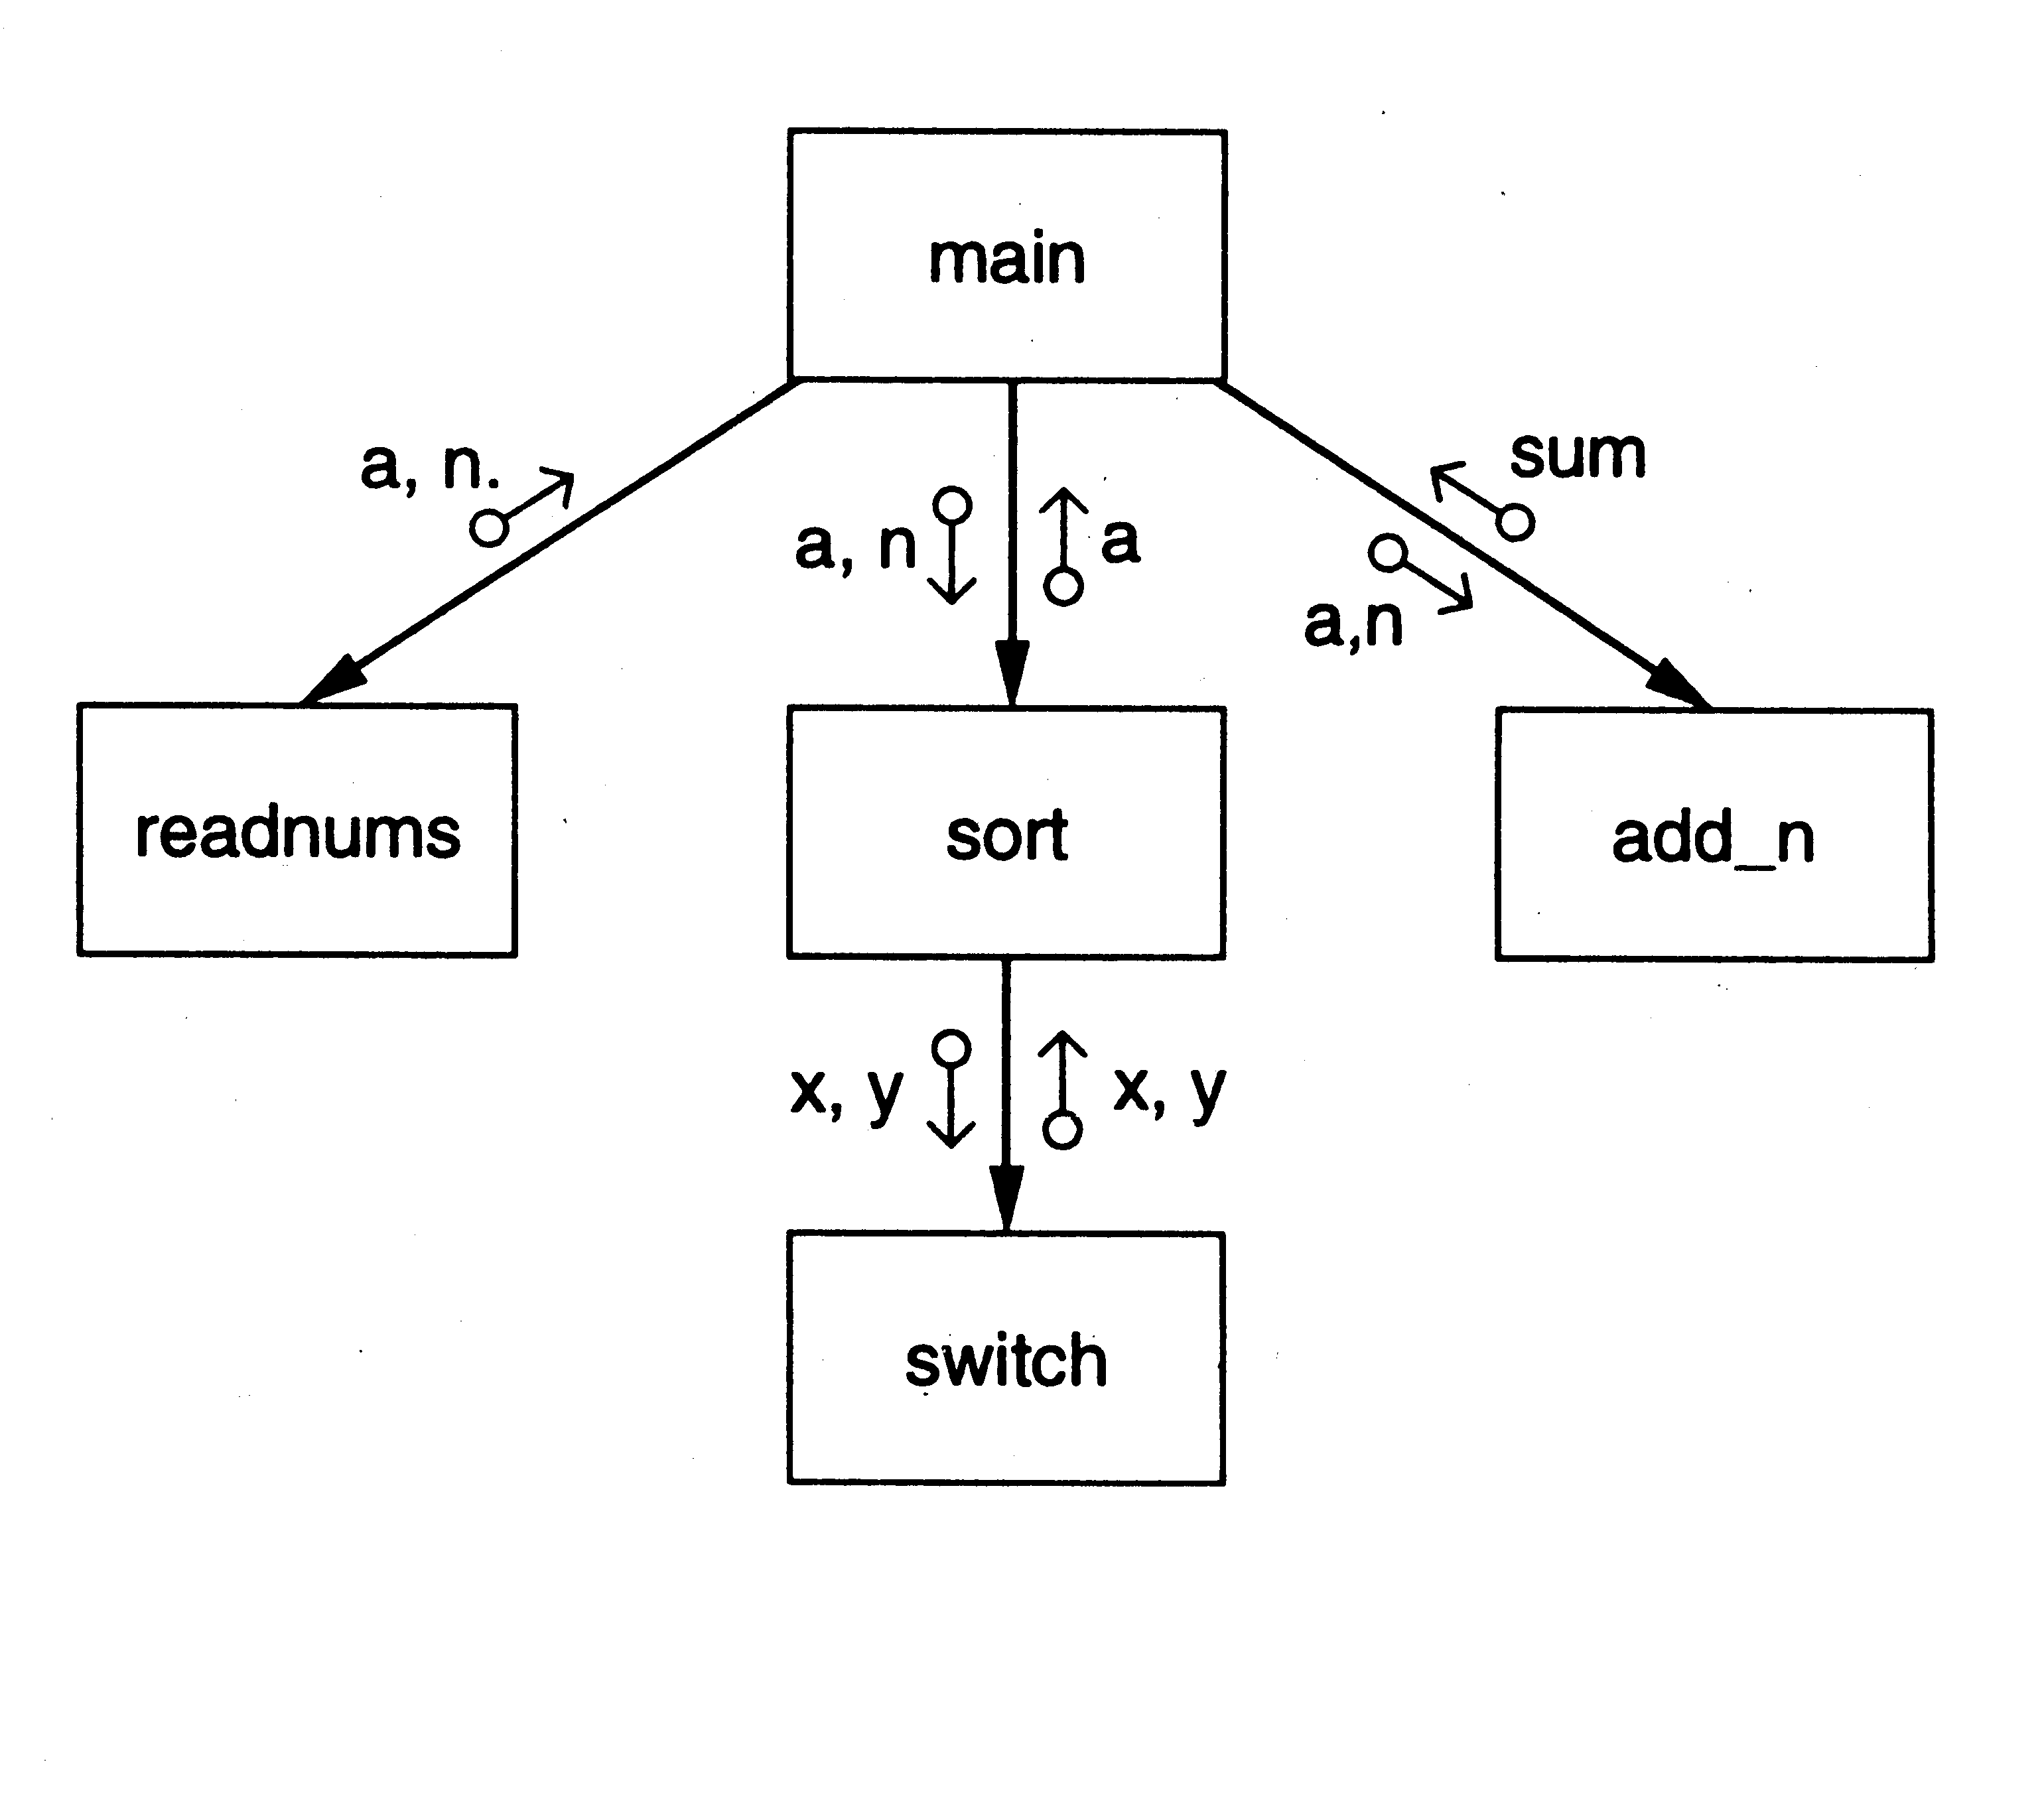
SC of a Sort Program

Slide 38
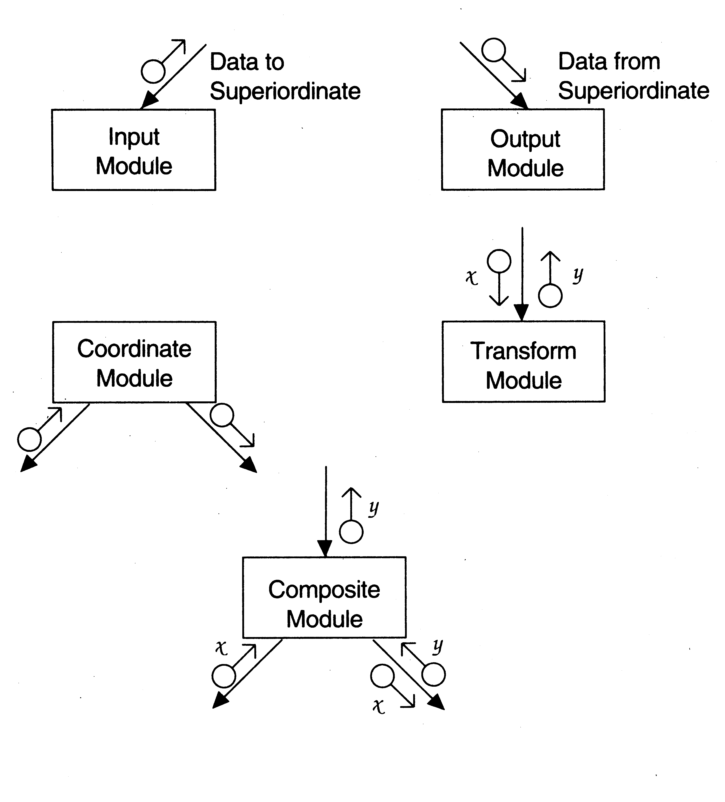
Diff types of modules

Slide 39
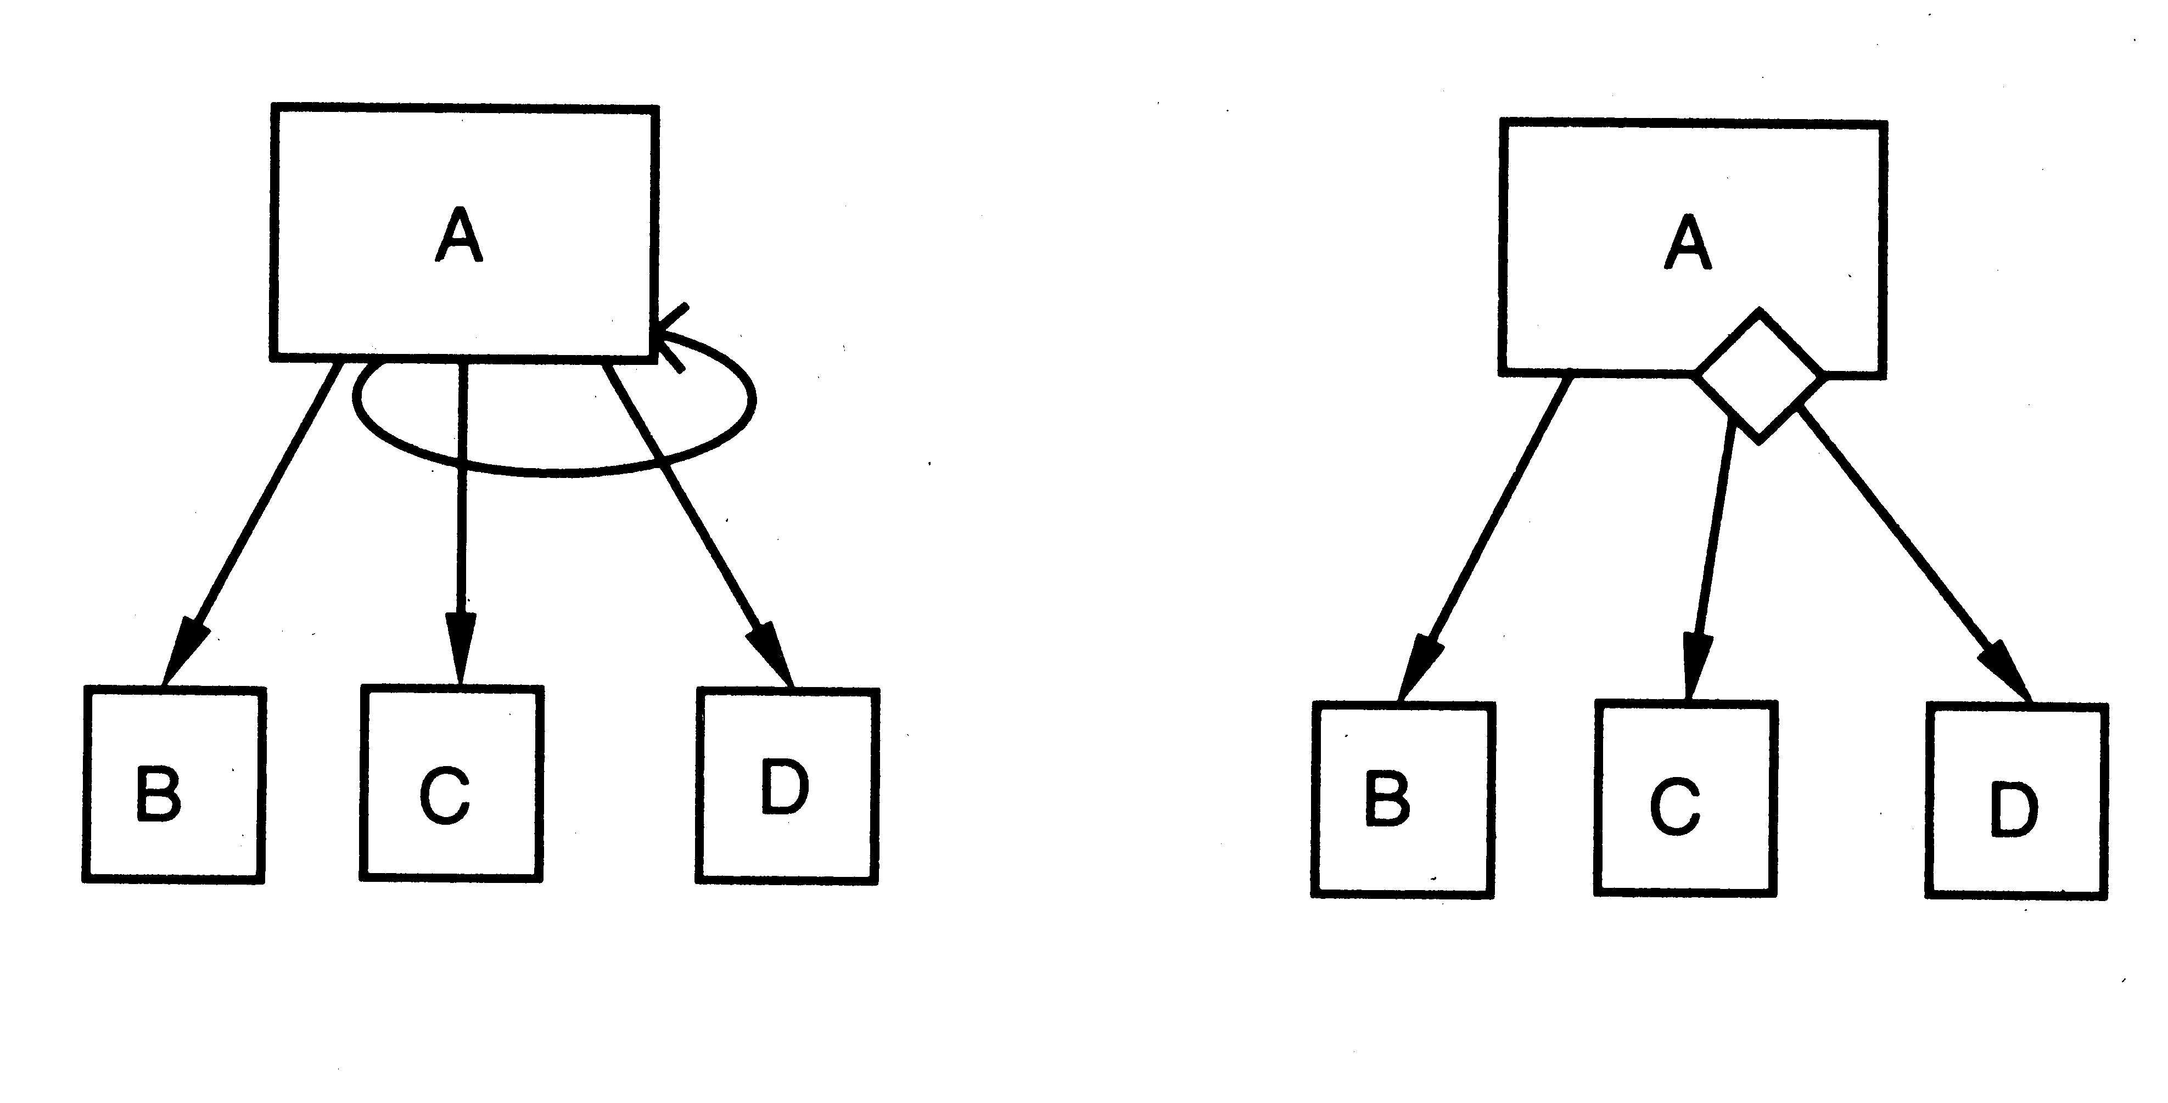
Iteration and decision

Slide 40
STRUCTURED DESIGN METHODOLOGY
SDM views software as a transformation function that converts given inputs to desired outputs
The focus of SD is the transformation function
Uses functional abstraction
Goal of SDM: Specify functional modules and connections
Low coupling and high cohesion is the objective
Transformation
functions
Input
Output

Slide 41
Steps in SD
Draw a DFD of the system
Identify most abstract inputs and most abstract outputs
First level factoring
Factoring of input, output, transform modules
Improving the structure

Slide 42
Data Flow Diagrams
SD starts with a DFD to capture flow of data in the proposed system
DFD is an important representation; provides a high level view of the system
Emphasizes the flow of data through the system
Ignores procedural aspects
(Purpose here is different from DFDs used in requirements analysis, though notation is the same)

Slide 43
Drawing a DFG
Start with identifying the inputs and outputs
Work your way from inputs to outputs, or vice versa
  If stuck, reverse direction
  Ask: "What transformations will convert the inputs to outputs"
Never try to show control logic.
  If thinking about loops, if-then-else, start again
Label each arrow carefully
Make use of * and +, and show sufficient detail
Ignore minor functions in the start
For complex systems, make dfd hierarchical
Never settle for the 1st dfd

Slide 44
Step 2 of SD Methodology
Generally a system performs a basic function
Often cannot be performed on inputs directly
First inputs must be converted into a suitable form
Similarly for outputs - the outputs produced
by main transforms need further processing
Many transforms needed for processing inputs and outputs
Goal of step 2 is to separate such transforms from the basic transform centers

Slide 45
Step 2…
Most abstract inputs: data elements in dfg that are furthest from the actual inputs, but can still be considered as incoming
These are logical data items for the transformation
May have little similarity with actual inputs.
Often data items obtained after error checking, formatting, data validation, conversion etc.

Slide 46
Step 2…
Travel from physical inputs towards outputs until data can no longer be considered incoming
Go as far as possible, without loosing the incoming nature
Similarly for most abstract outputs
Represents a value judgment, but choice is often obvious
Bubbles between mai and mao: central transforms
These transforms perform the basic transformation
With mai and mao the central transforms can concentrate on the transformation

Slide 47
Step 2…
Problem View: Each system does some i/o and some processing
In many systems the i/o processing forms the large part of the code
This approach separates the different functions
  subsystem primarily performing input
  subsystem primarily performing transformations
  subsystem primarily performing output presentation

Slide 48
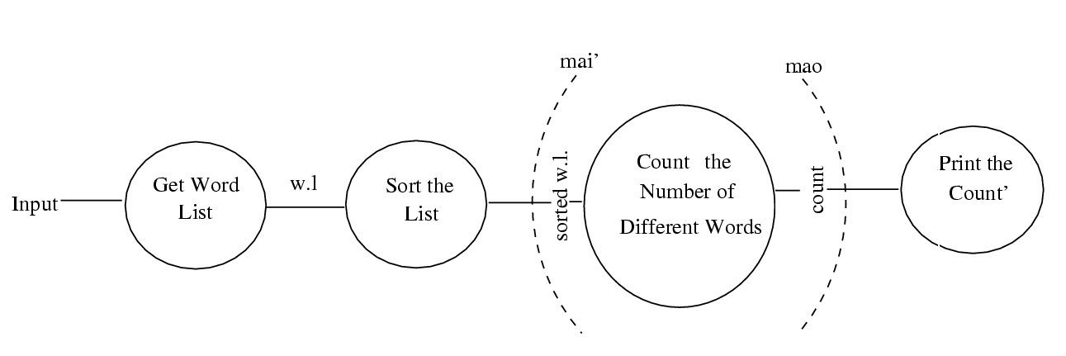
Example 1 – counting the no of different words in a file

Slide 49
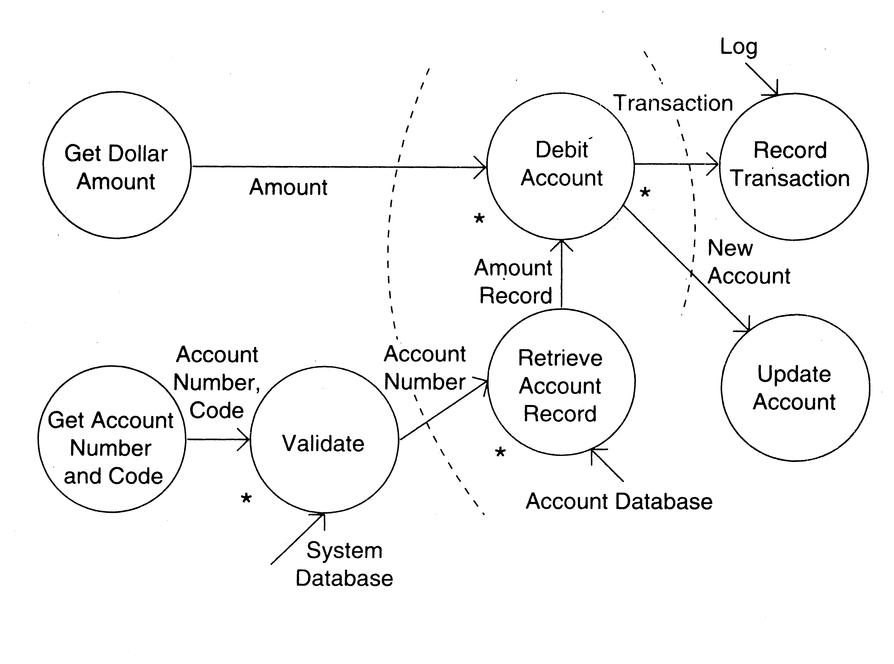
Example 2 – ATM

Slide 50
First Level Factoring
First step towards a structure chart
Specify a main module
For each most abstract input data item, specify a subordinate input module
The purpose of these input modules is to deliver to main the mai data items
For each most abstract output data element, specify an output module
For each central transform, specify a subordinate transform module
Inputs and outputs of these transform modules are specified in the DFD

Slide 51
First level factoring is straight forward
Main module is a coordinate module
Some subordinates are responsible for delivering the logical inputs
These are passed to transform modules to get them converted to logical outputs
Output modules then consume them
Divided the problem into three separate problems
Each of the three diff. types of modules can be designed separately
These modules are independent

Slide 52
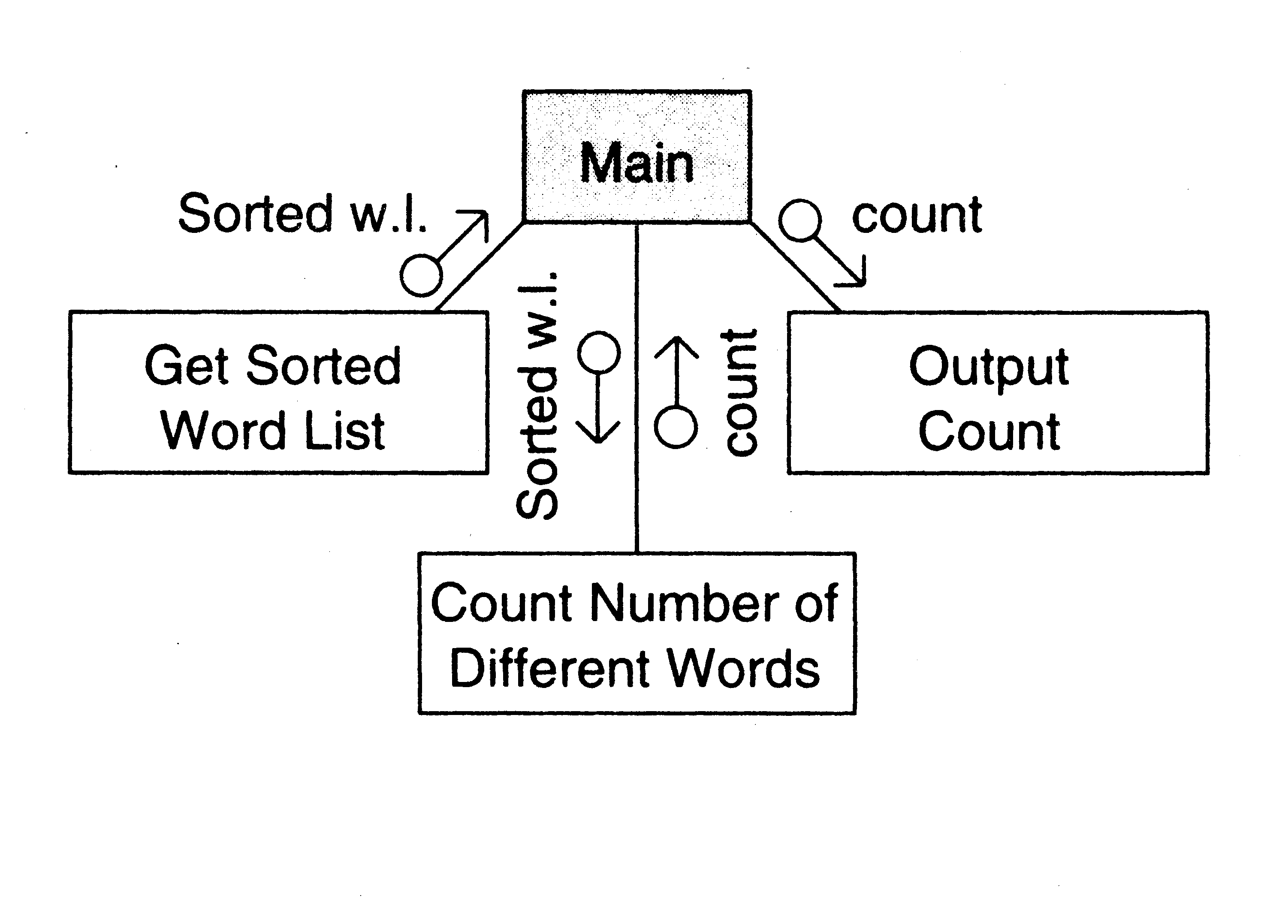
Example 1

Slide 53
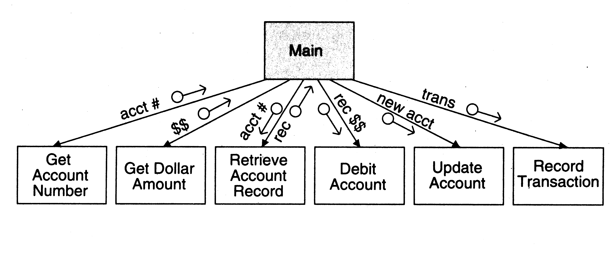
Example 2

Slide 54
Factoring Input modules
The transform that produced the mai data is treated as the central transform
Then repeat the process of first level factoring
Input module being factored becomes the main module
A subordinate input module is created for each data item coming in this new central transform
A subordinate module is created for the new central transform
Generally there will be no output modules

Slide 55
The new input modules are factored similarly Till the physical inputs are reached
Factoring of the output modules is symmetrical
Subordinates - a transform and output modules
Usually no input modules

Slide 56
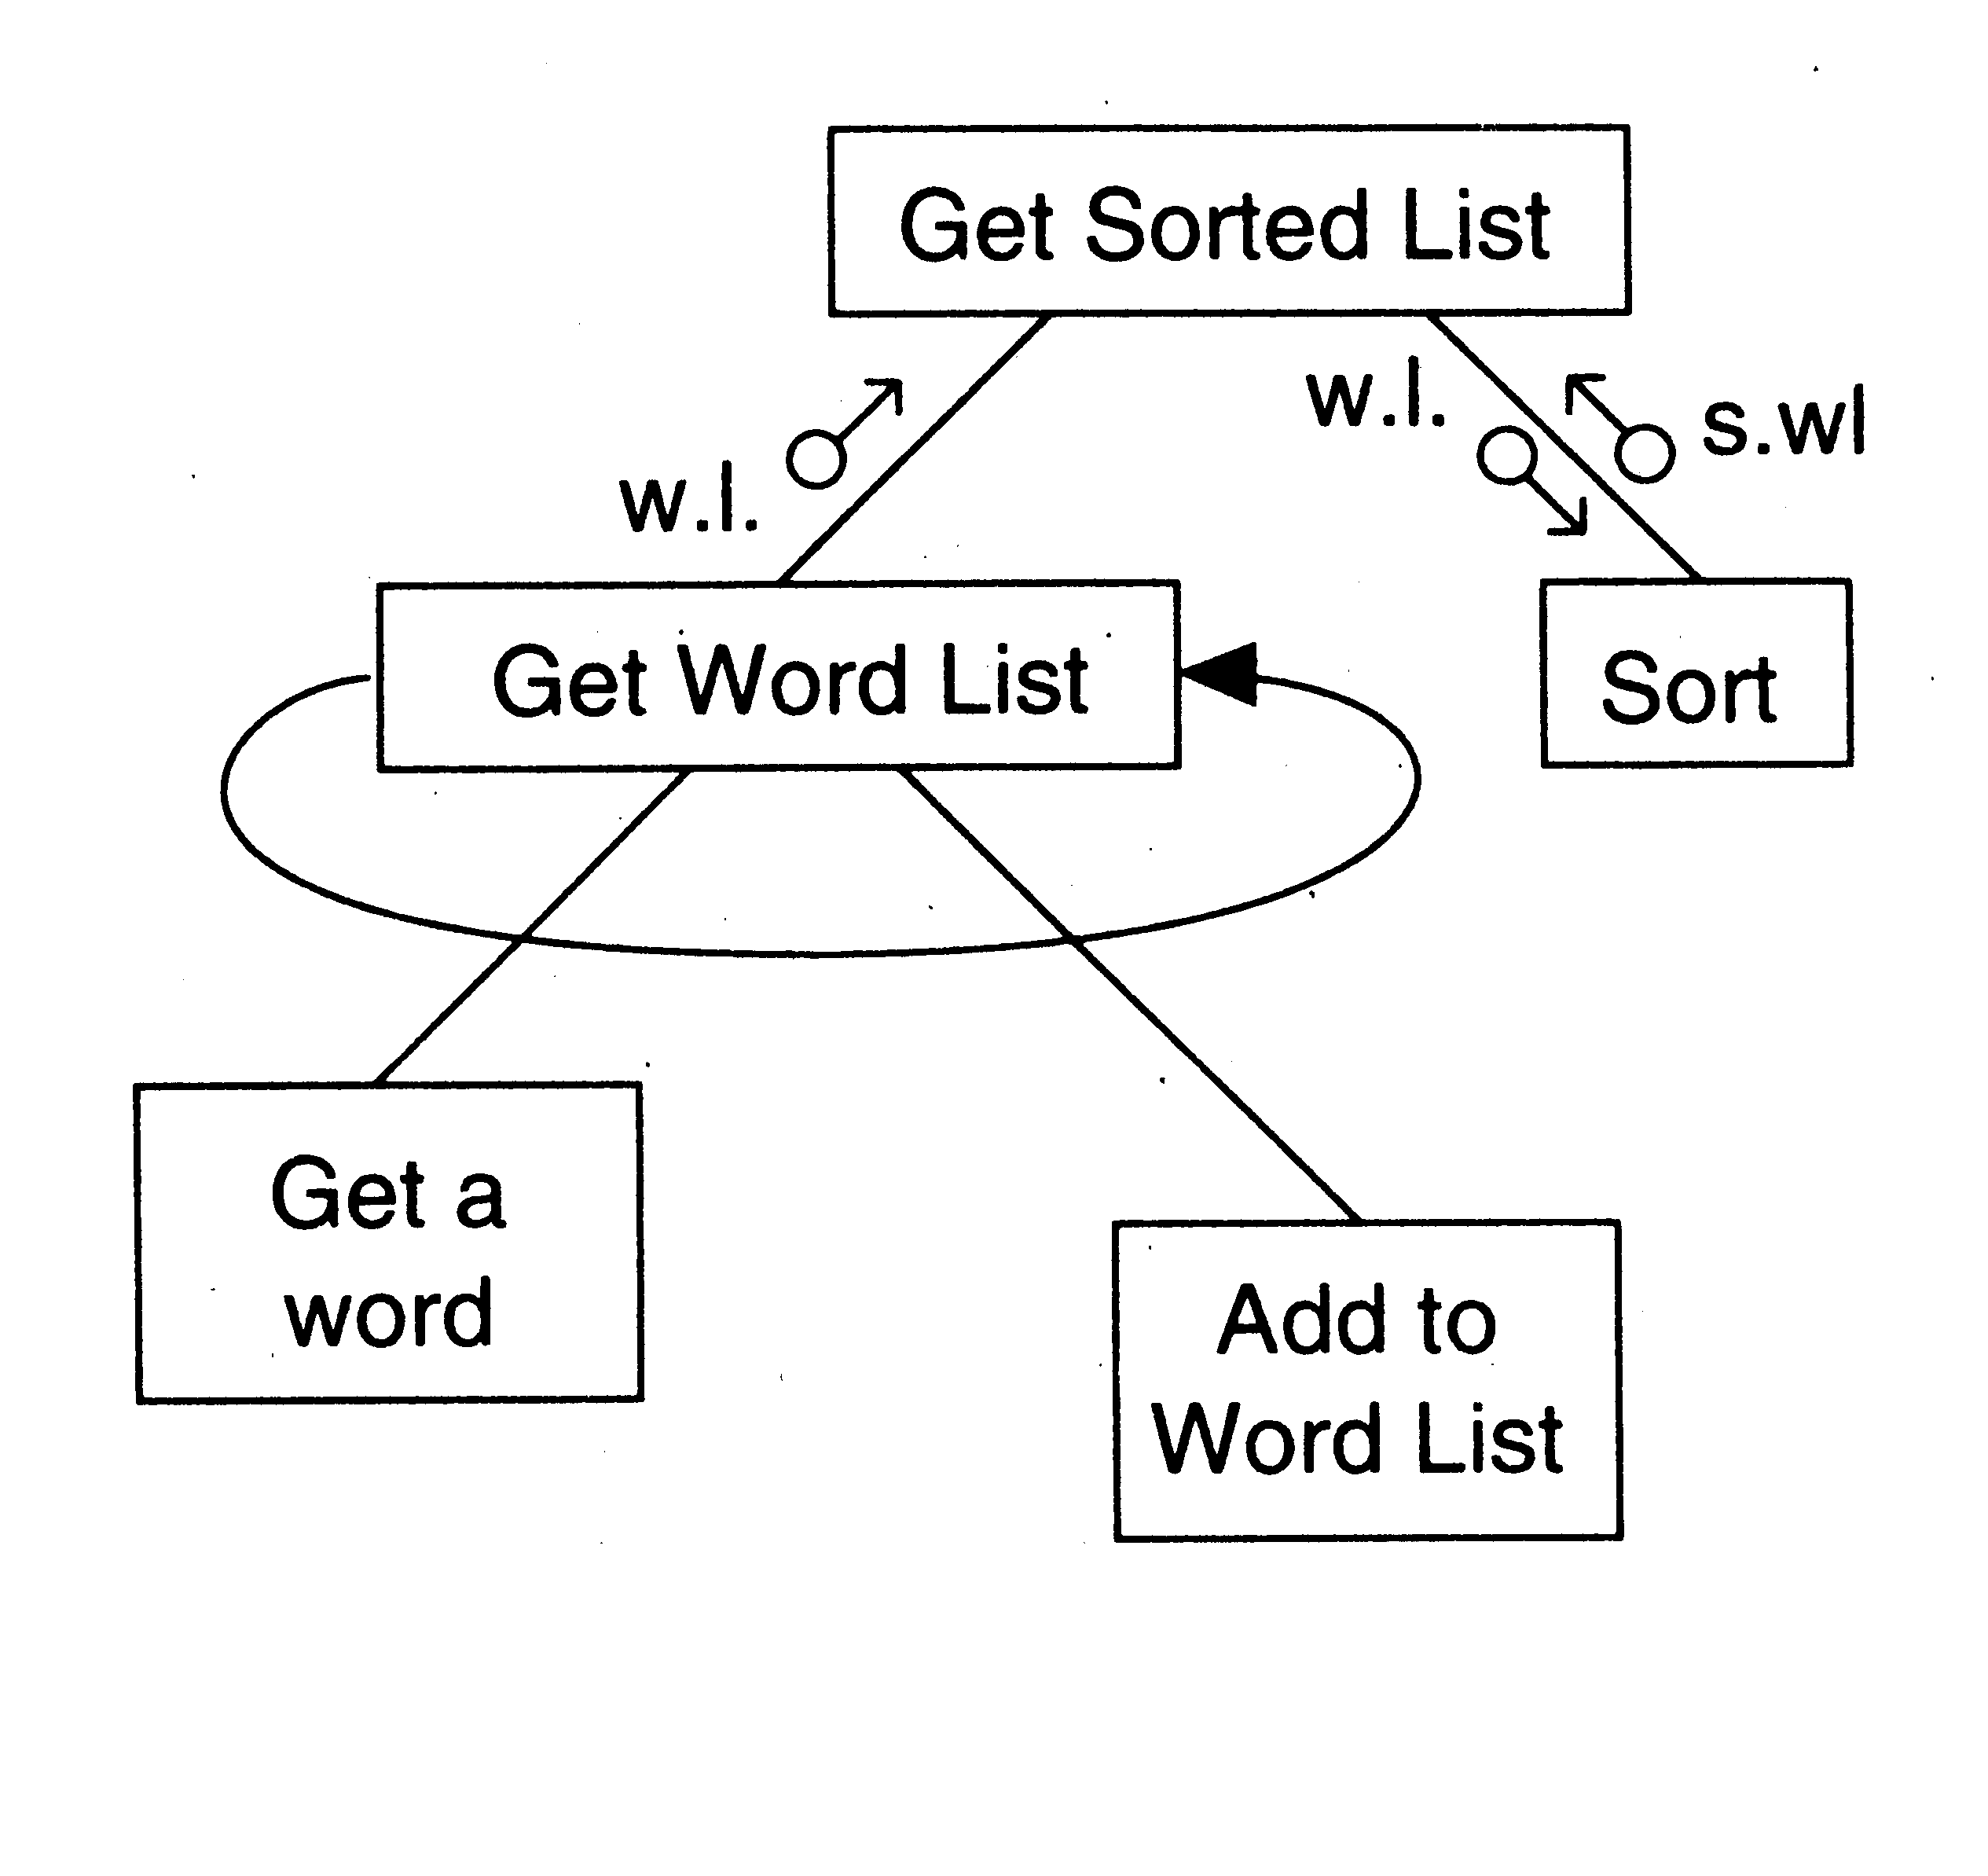
Example 1

Slide 57
Factoring Central Transforms
Factoring i/o modules is straight forward if the DFD is detailed
No rules for factoring the transform modules
Top-down refinement process can be used
Goal: determine sub-transforms that will together compose the transform
Then repeat the process for newly found transforms
Treat the transform as a problem in its own right
Draw a data flow graph
Then repeat the process of factoring
Repeat this till atomic modules are reached

Slide 58
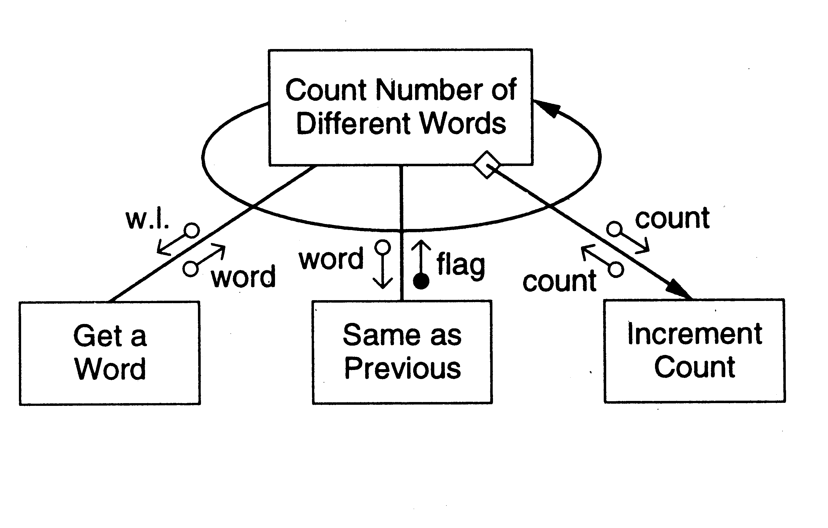
Example 1

Slide 59
Design Heuristics
The above steps should not be followed blindly
The structure obtained should be modified if needed
Low coupling, high cohesion being the goal
Design heuristics used to modify the initial design
Design heuristics - A set of thumb rules that are generally useful
Module Size: Indication of module complexity Carefully examine modules less than a few lines or greater than about 100 lines
Fan out and fan in
A high fan out is not desired, should not be increased beyond 5 or 6
Fan in should be maximized

Slide 60
Scope of effect of a module: the modules affected by a decision inside the module
Scope of control: All subordinates of the module
Good thumb rule:
For each module scope of effect should be a subset of scope of control
Ideally a decision should only effect immediate subordinates
Moving up the decision, moving the module down can be utilized to achieve this

Slide 61
Transaction Analysis
The above approach is transform analysis
In this data flows from input to output through various transforms
In transaction processing type situations, many different types of processing are done depending on type
The DFD of such a system shows a bubble splitting data into many streams
In execution, one of the streams is followed
Transaction analysis is best for this

Slide 62
DFD shown in figure
Note the use of + signifying OR
There is a transaction center, T
T takes input & then performs different transformations
This can be converted to SC as shown
In smaller systems, dispatching may be done in the transaction center itself

Slide 63
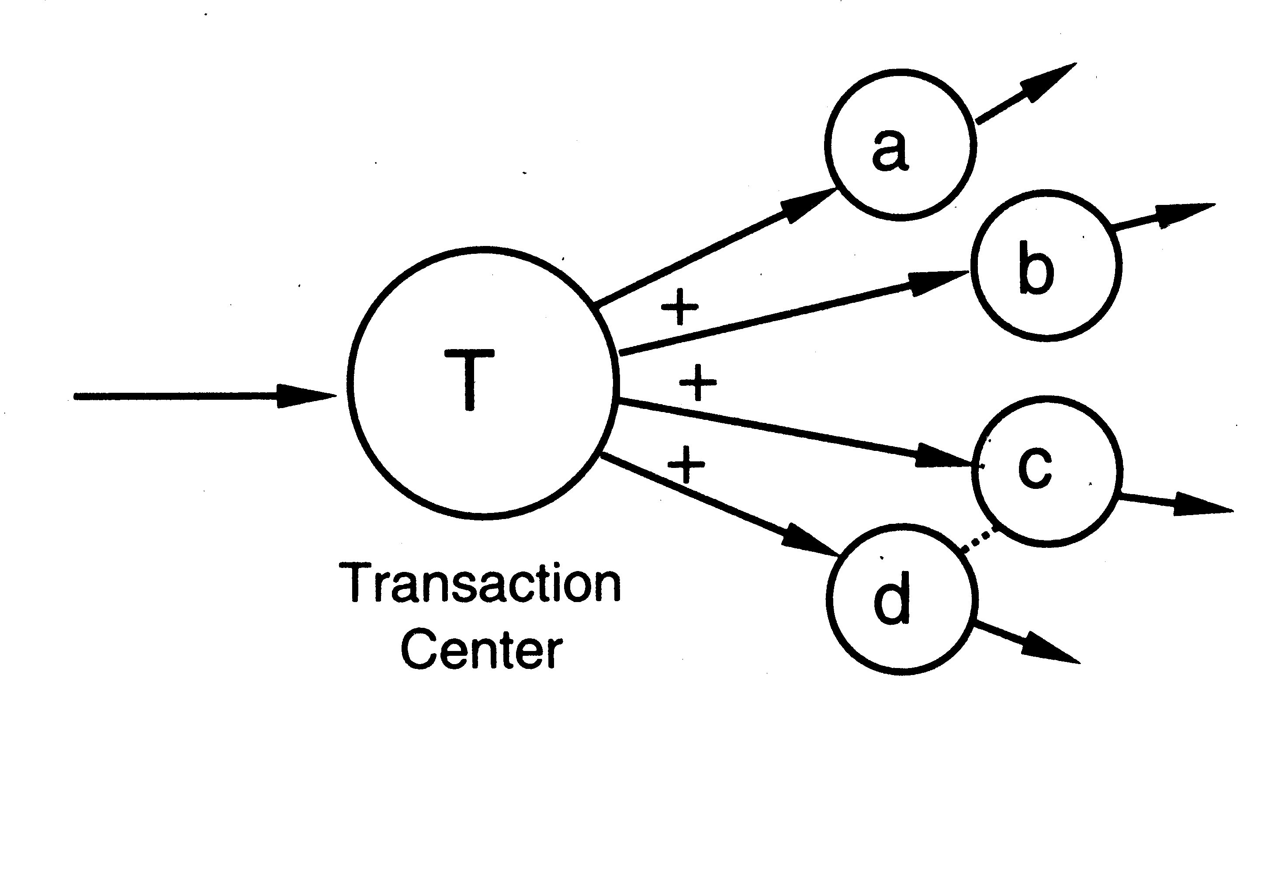
DFD for transaction analysis

Slide 64
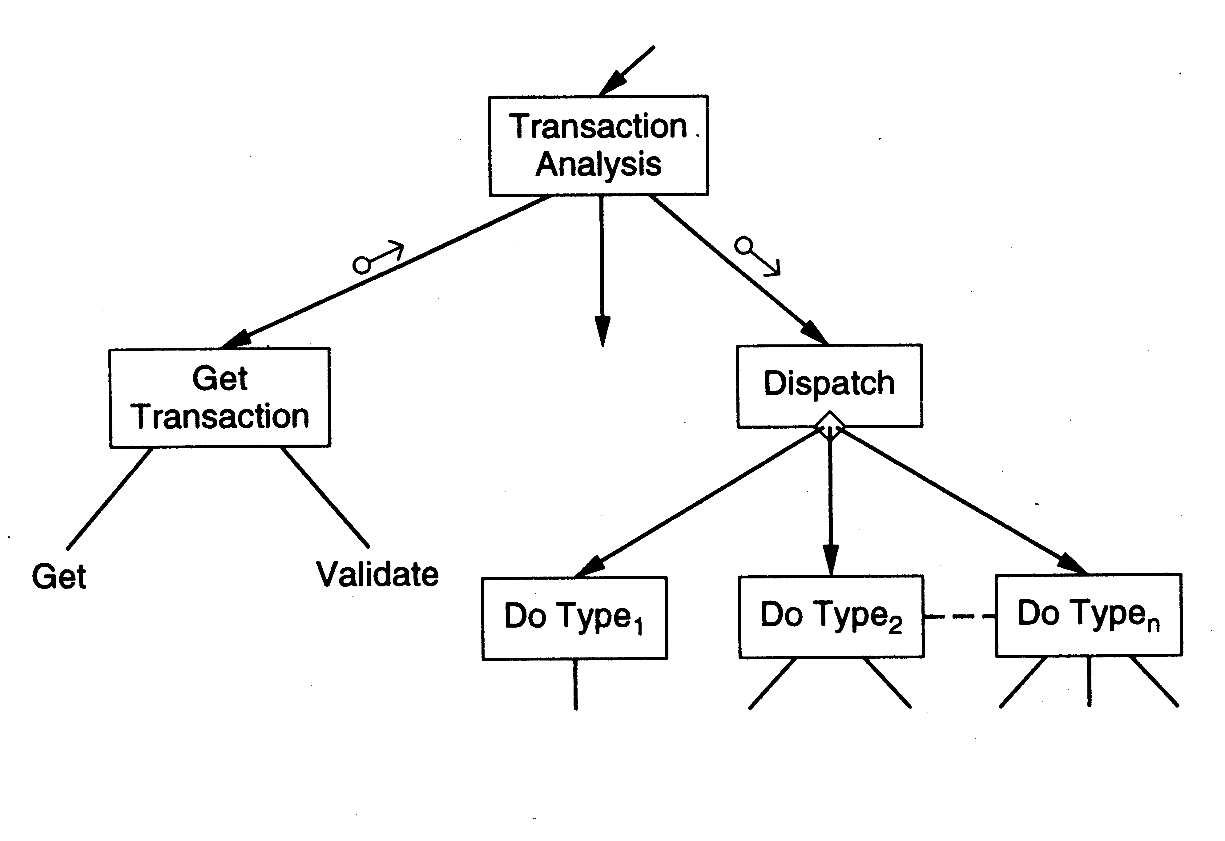
Transaction analysis…

Slide 65
Summary
Goal of design phase: produce simpler & modular design
Structured design methodology is one way to create modular design
It partitions the system into input subsystems, output subsystems & transform subsystems
Idea: Many systems use a lot of code for handling inputs & outputs
SDM separates these concerns
Then each of the subsystems is factored using the DFD
The design is finally documented & verified before proceeding

Slide 66
Detailed Design
HLD does not specify module logic
This is done during detailed design
Process Design Logic (PDL) can also be used for detailed design of modules
PDL can be used to specify the complete design - architectural as well as logic design
The degree of detail desired is decided by the designer
One way to communicate a design: use natural language
Is imprecise and can lead to misunderstanding

Slide 67
Other extreme is to use a formal language
Such representations often have a lot of detail,
  necessary for implementation, but
  not important for communicating the design
These details are often a hindrance to understanding

Slide 68
Ideally would like a language that is
  as precise as possible
  Does not need too much detail,
  target language independent
  can be easily converted in to an implementation
This is what PDL attempts to do.
PDL has outer syntax of a structure programming language
Vocabulary of a natural language (English in our case)
It can be thought as "structured english"
Some automated processing can be done on PDL

Slide 69
E.g.. determine the min and max of a set of numbers in a file
A design in PDL is:
  minmax (in file)
  ARRAY a
  DO UNTIL end of input
  READ an item into a
  ENDDO
  max, min: = first item of a
  DO FOR each item in a
  IF max < item THEN set max to item
  IF min > item THEN set min to item
  ENDDO
  END

Slide 70
The entire logic is described
Few implementation details
For implementation, the pseudo statements will have to be
  converted into programming language statements
A design can be expressed in level of detail
  suitable for the problem
PDL allows a successive refinement approach
Encourages use of structured language constructs

Slide 71
The basic constructs of PDL
if-then-else construct Like Pascal
Conditions and the statements need not be stated formally
A general CASE statement
Some examples of CASE
  CASE OF transaction type
  CASE OF operator type
The DO construct: used to indicate repetition
  DO iteration criteria
  one or more statements
  ENDDO

Slide 72
The iteration criteria need not be stated formally
Examples of valid use are:
  DO WHILE there are characters in input file
  DO UNTIL the end of file is reached
  DO FOR each item in the list EXCEPT when item is zero.
A variety of data structures can be defined Eg. list, tables, scalar, records, arrays etc. All constructs should be programmable

Slide 73
Design Verification
Main objective: does the design implement the requirements
Analysis for performance, efficiency, etc may also be done
If formal languages used for design representation, tools can help
Design reviews remain the most common approach for verification

Slide 74
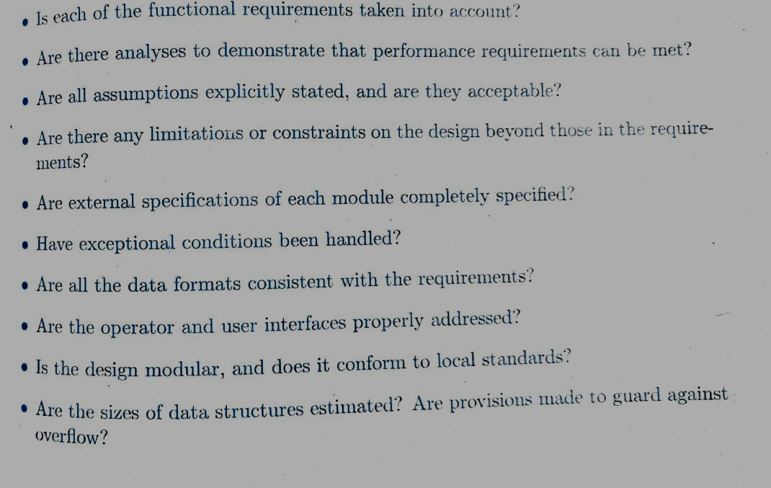

Slide 75
Metrics

Slide 76
Background
Basic purpose to provide a quantitative evaluation of the design (so the final product can be better)
Size is always a metric – after design it can be more accurately estimated
  Number of modules and estimated size of each is one approach
Complexity is another metric of interest – will discuss a few metrics

Slide 77
Network Metrics
Focus on structure chart; a good SC is considered as one with each module having one caller (reduces coupling)
The more the SC deviates from a tree, the more impure it is
Graph impurity = n – e – 1
n – nodes, e- edges in the graph
Impurity of 0 means tree; as this no increases, the impurity increases

Slide 78
Stability Metrics
Stability tries to capture the impact of a change on the design
Higher the stability, the better it is
Stability of a module – the number of assumptions made by other modules about this module
  Depends on module interface, global data the module uses
  Are known after design

Slide 79
Information Flow Metrics
Complexity of a module is viewed as depending on intra-module complexity
Intramodule estimated by module size and the information flowing
  Size in LOC
  Inflow – info flowing in the module
  Outflow – info flowing out of the module
Dc = size * (inflow * outflow)²

Slide 80
Information flow metrics…
(inflow * outflow) represents total combination of inputs and outputs
Its square reps interconnection between the modules
Size represents the internal complexity of the module
Product represents the total complexity

Slide 81
Identifying error-prone modules
Uses avg complexity of modules and std dev to identify error prone and complex modules:
  Error prone: If Dc > avg complexity + std_dev
  Complex: If avg complexity < Dc < avg + std dev
  Normal: Otherwise

Slide 82
Metrics with detailed design
When logic is known, internal complexity metrics can be determined
We will cover all detailed design based metrics along with code metrics

